Slide 1
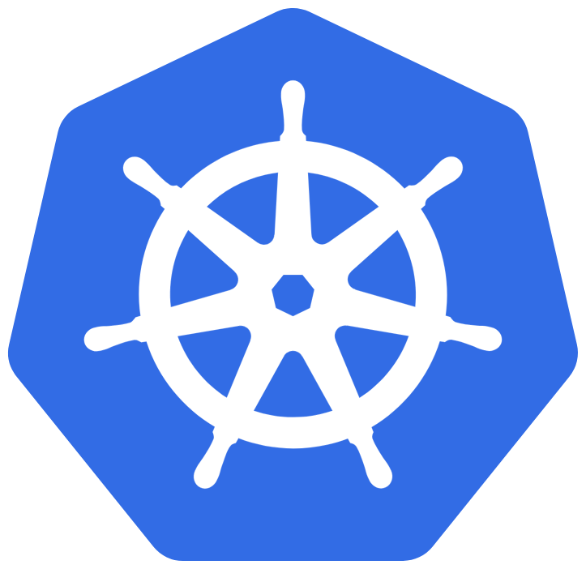
Kubernetes

Slide 2


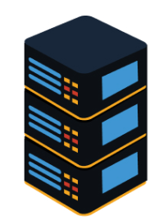
2 core, 4gb RAM

Slide 3

2 core, 4gb RAM

Slide 4
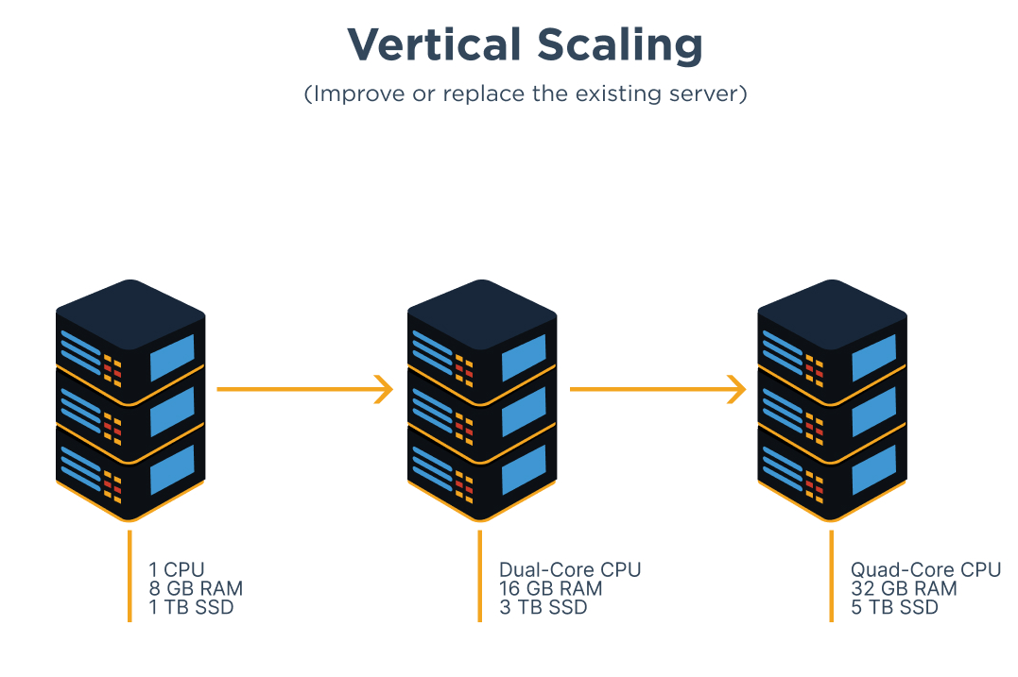

Slide 5
64 core, 1024gb RAM

Slide 6
64 core, 1024gb RAM

Slide 7
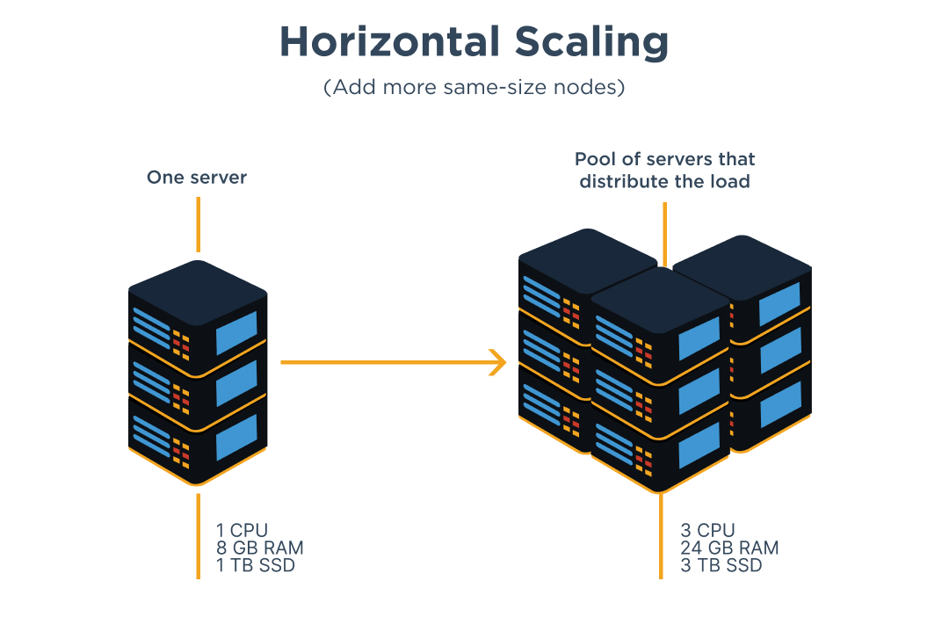

Slide 9
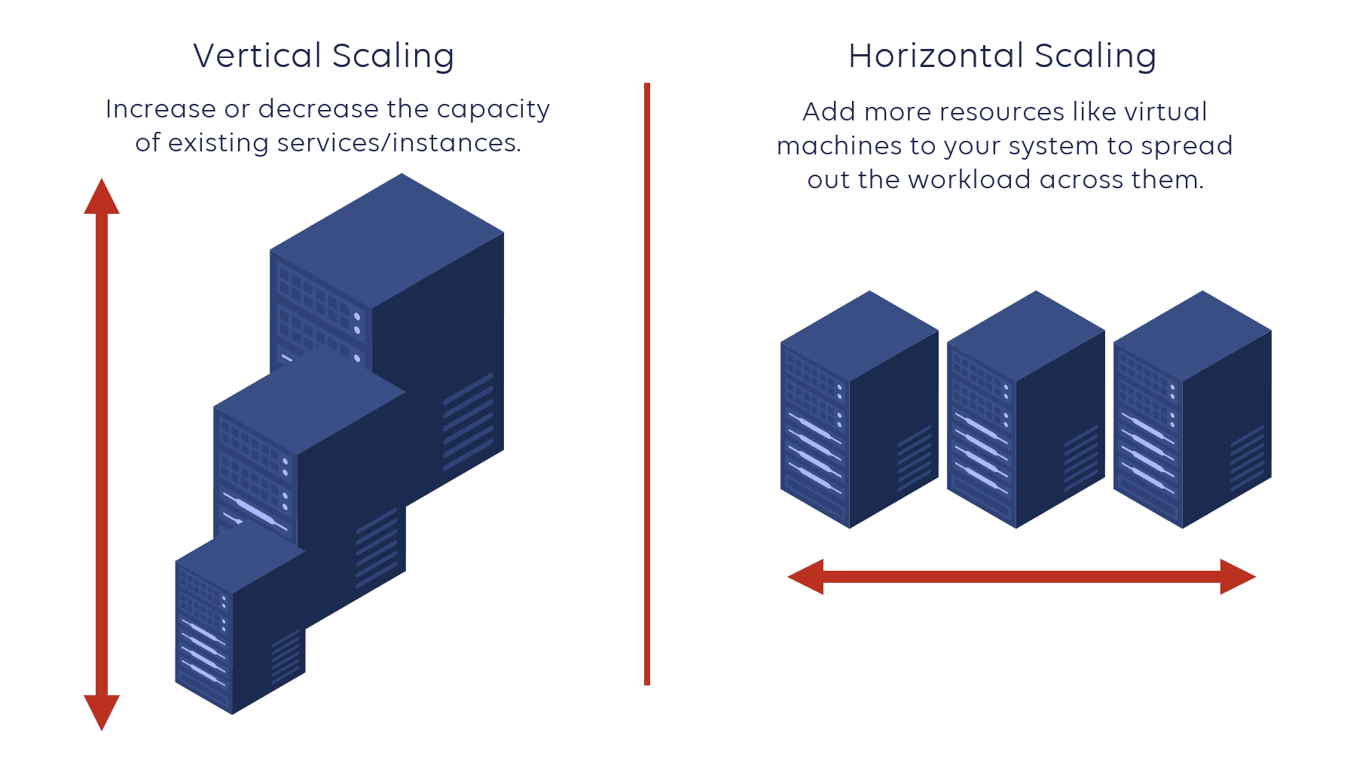
Horizontal vs. Vertical Scaling
Horizontal scaling adds more machines to distribute load.
Vertical scaling increases the power of existing machines.

Slide 10

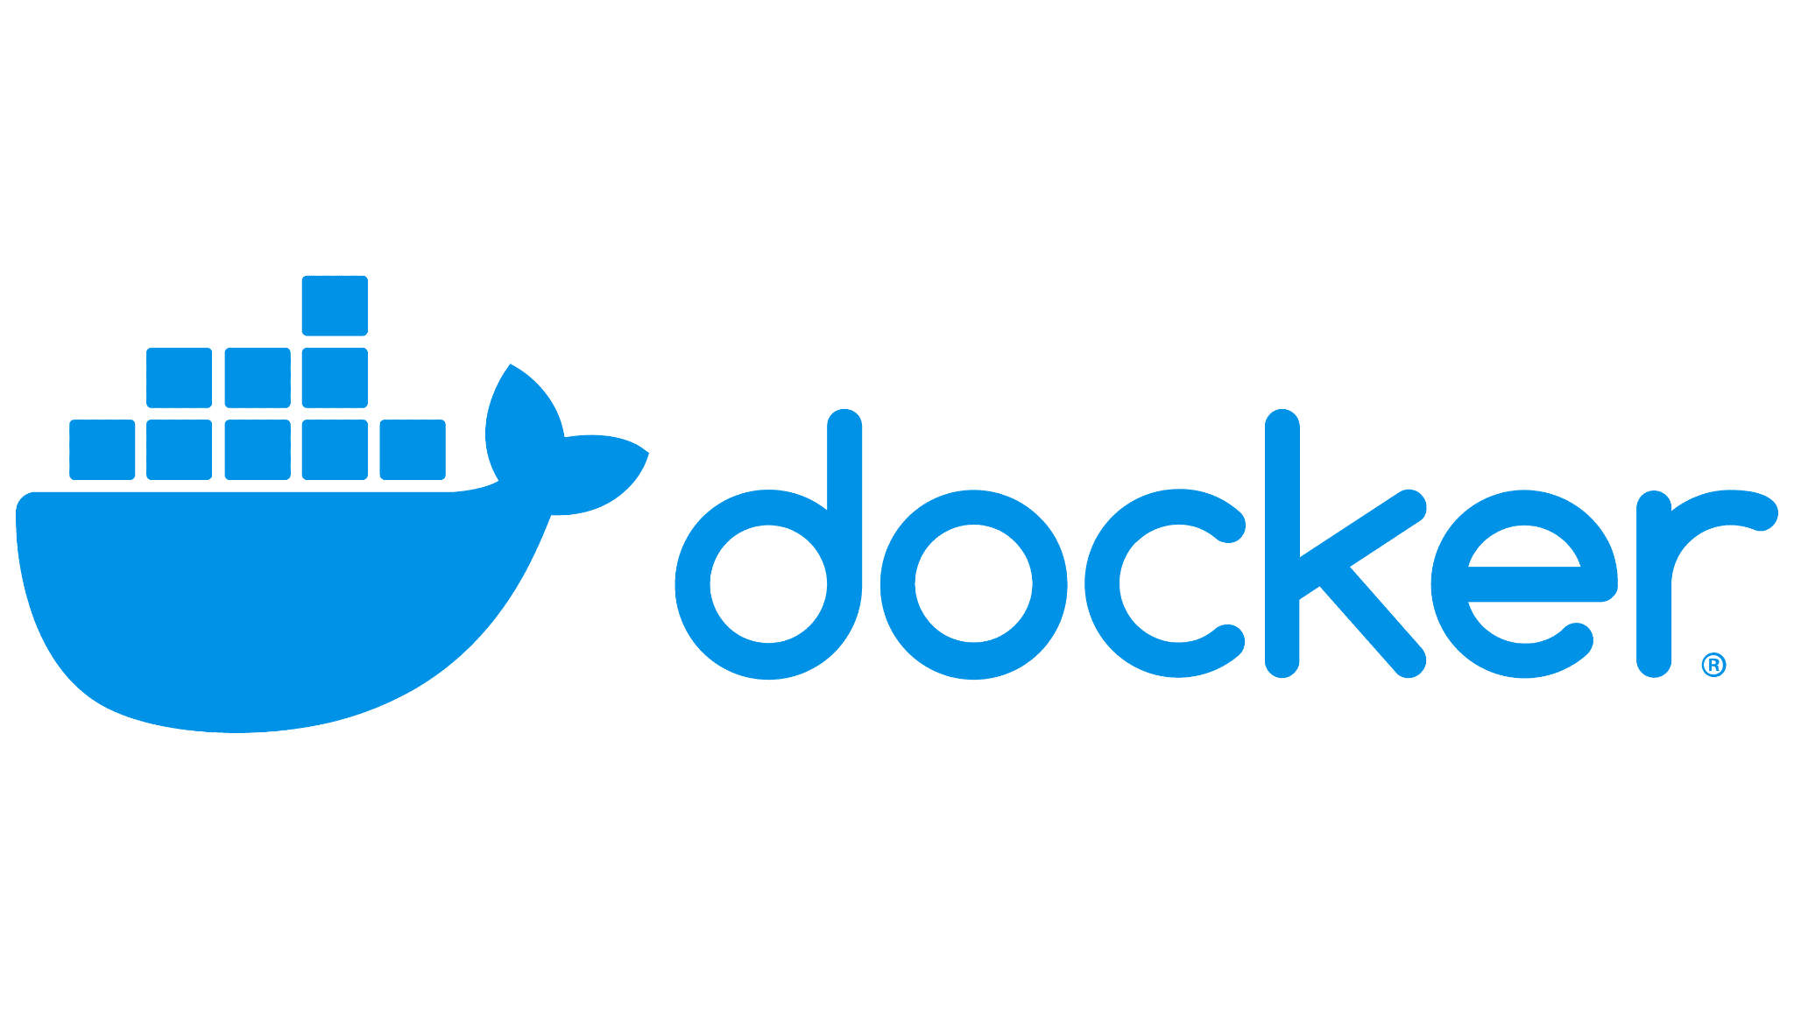
A Short Footnote - Containers (Docker)
Containers are a self-contained unit of software
All code and dependencies packaged up into this unit
Essentially a virtual machine designed explicitly for running one piece of software
“It works on my machine”

Slide 11
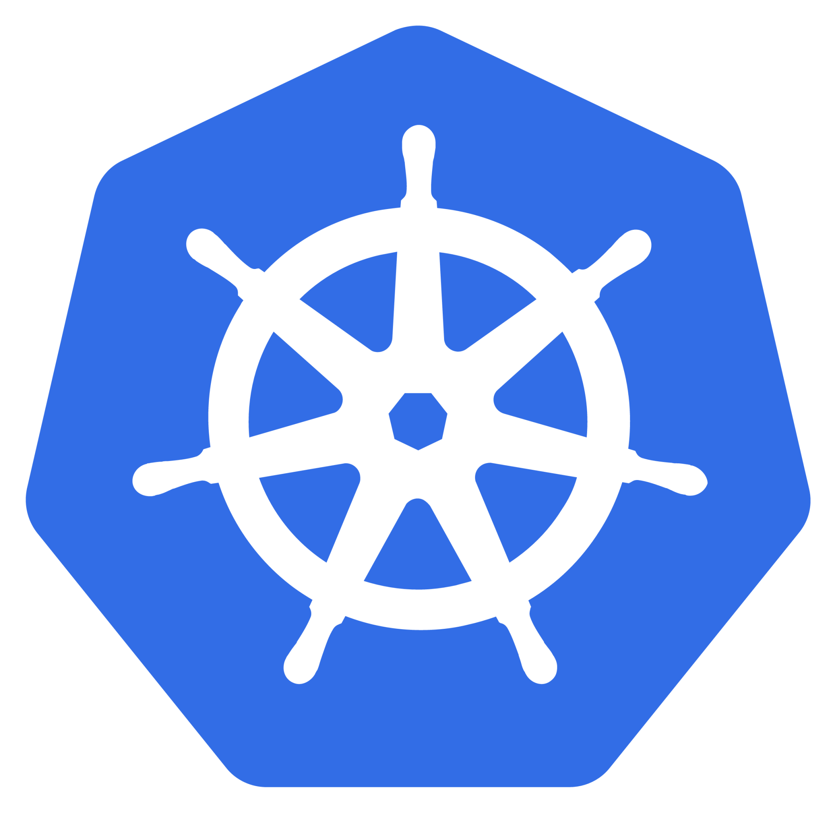
Kubernetes
Open-source system for automating deployment, scaling, and management of containerized applications
Groups containers into units called “pods”
Deployment manifest - declarative

Slide 12
Benefits of Kubernetes
Automatic horizontal scaling for efficient resource utilization.
If a service needs more resources, you can add extra pods for it and distribution of requests is handled automatically
Cost-effective solution for managing workloads.
Locality awareness enhances performance and reduces latency.

Slide 13


Why not just scale vertically?
Vertical scaling reaches capacity, limiting further growth.
Vertical scaling has diminishing returns at high level
Horizontal scaling enables automatic expansion for web servers.

Slide 14
Web Server Scaling with Subdomains
east
Kubernetes allows you to configure separate deployments for each region using subdomains
Automatic scaling ensures seamless performance under heavy loads
Automatic routing by determining users location
west
Adds additional pods for increased traffic

Slide 15
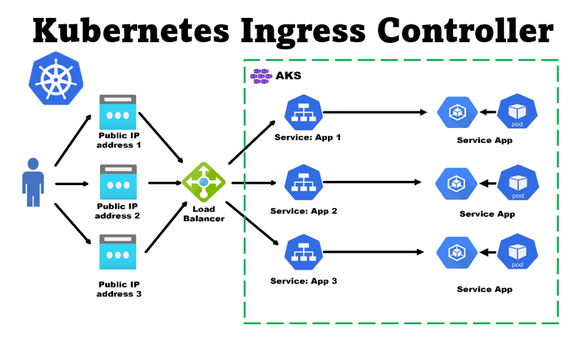

Slide 16
Optimizing Kubernetes for Scalability
Scaling Thresholds specified by deployment manifest
Metrics (CPU/MEM use) that trigger automatic scaling
Fine-tuning these metrics for optimal performance and resource allocation

Slide 17
sudo docker build -t my-flask-app:0.0.2 .
docker run -d -p 5000:5000 --restart=always --name local-registry registry:2
docker tag my-flask-app localhost:5000/my-flask-app
docker push localhost:5000/my-flask-app
minikube start --disk-size=2g
kubectl apply -f app-deployment.yaml
kubectl apply -f app-service.yaml
minikube service my-flask-app-service
from flask import Flask
app = Flask(__name__)
@app.route('/')
def hello_world():
return 'Hello, World!'

Slide 18
apiVersion: apps/v1
kind: Deployment
metadata:
name: my-flask-app-deployment
spec:
replicas: 1
selector:
matchLabels:
app: my-flask-app
template:
metadata:
labels:
app: my-flask-app
spec:
containers:
- name: my-flask-app
image: my-flask-app:0.0.1
imagePullPolicy: Never
ports:
- containerPort: 5000
apiVersion: v1
kind: Service
metadata:
name: my-flask-app-service
spec:
type: NodePort
ports:
- port: 5000
targetPort: 5000
protocol: TCP
selector:
app: my-flask-app

